Slide 1

Chapter 2
Integrating images

Slide 2
Learning Objectives
How to use the <img> tag to place an image within a Web page
The difference between relative and absolute image URLs
Why and how to specify alternative text for an image
How to specify an image’s height and width using <img> tag attributes
Why you should scale your images using photo-editing software
How to center an image within a Web page
How copyrights affect which images you and can’t use within a Web page
How image resolution impacts image size which effects your page download speed
How to display a page background image
How to display an image border and how to use the border to round image corners

Slide 3
Learning objectives continued
How to pad an image with pixels to provide space between the image and other page elements
How to control image opacity
How to align text and images
How to position an image
How to rotate an image

Slide 4
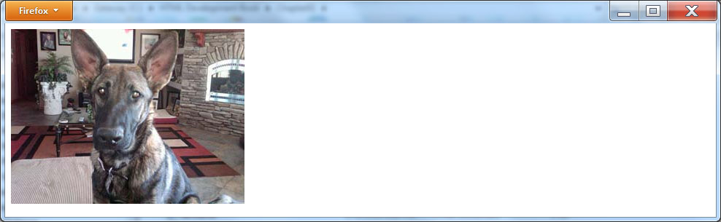
Placing an Image within a Web Page
<!DOCTYPE html> <html> <body> <img src="http://www.websitedevelopmentbook.com/Chapter02/dog.jpg"/> </body> </html>

Slide 5
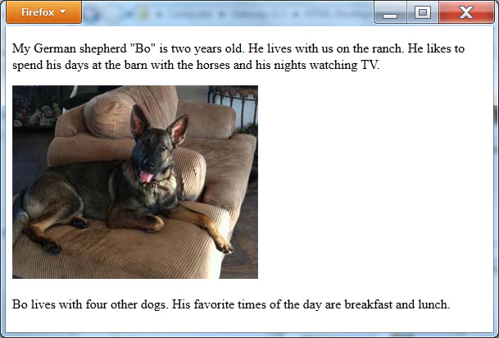
<img> tag within other content
<!DOCTYPE html> <html> <body> <p>My German Shepard "Bo" is two-years old. He lives with us on the ranch. He likes to spend his days at the barn with the horses and his nights watching TV.</p> <img src="http://www.websitedevelopmentbook.com/Chapter02/dogsofa.jpg"/> <p>Bo lives with 4 other dogs. His favorite times of the day are breakfast and lunch.</p> </body> </html>

Slide 6
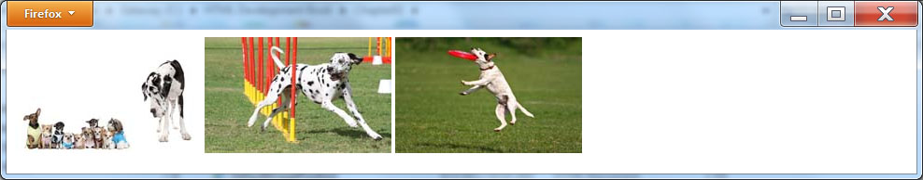
Side by side images
<!DOCTYPE html> <html> <body> <img src="http://www.websitedevelopmentbook.com/Chapter02/group.jpg"/> <img src="http://www.websitedevelopmentbook.com/Chapter02/agility.jpg"/> <img src="http://www.websitedevelopmentbook.com/Chapter02/frisbee.jpg"/> </body> </html>

Slide 7
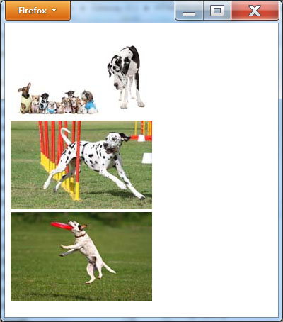
Stacking images
<!DOCTYPE html> <html> <body> <img src="http://www.websitedevelopmentbook.com/Chapter02/group.jpg"/><br/> <img src="http://www.websitedevelopmentbook.com/Chapter02/agility.jpg"/><br/> <img src="http://www.websitedevelopmentbook.com/Chapter02/frisbee.jpg"/><br/> </body> </html>

Slide 8
Understanding Relative Image URLs
When you place an <img> tag within an HTML file, you use the src attribute to tell the browser where to locate the image file.
The previous HTML files used absolute URLs to specify the each image location, meaning, each URL began with http:// and then specified site holding the file as well as the path (folder location and filename) to file.
Often, to better organize your files, you will place images for your Web site within a specific folder. In such cases, you can use a relative URL to specify the image location (as opposed to have to specify the complete site).
Likewise, there may be times when simply place your image files in the same folder as the HTML file.

Slide 9
Relative URL example
<!DOCTYPE html> <html> <body> <img src="dog.jpg"/><br/> </body> </html>

Slide 10
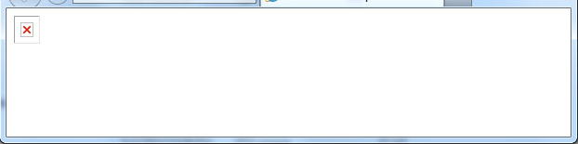
Broken image link
Note: Web developers often upload an HTML file to a Web server and forget to also upload the corresponding image files. For users across the Web to be able to view the Web page with the images, the image files must reside on a Web server along with the HTML file

Slide 11

Specifying an alternative text
<!DOCTYPE html> <html> <body> <img src="http://www.websitedevelopmentbook.com/Chapter02/missing.jpg" alt="Photo of a German shepherd"/> </body> </html>

Slide 12
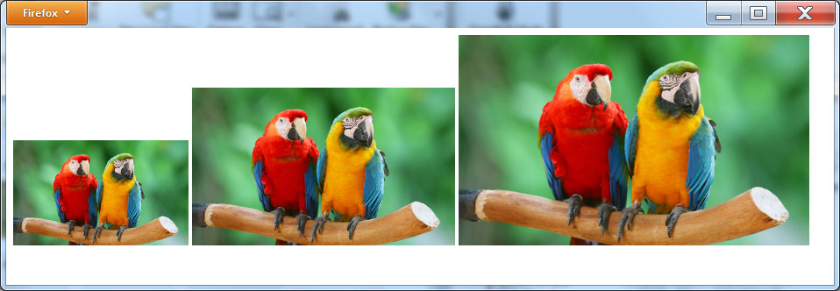
Controlling an image height and width
<!DOCTYPE html> <html> <body> <img src="http://www.websitedevelopmentbook.com/Chapter02/parrot.jpg" width="200" height="120"/> <img src="http://www.websitedevelopmentbook.com/Chapter02/parrot.jpg" width="300" height="180"/> <img src="http://www.websitedevelopmentbook.com/Chapter02/parrot.jpg" width="400" height="240"/> </body> </html>

Slide 13
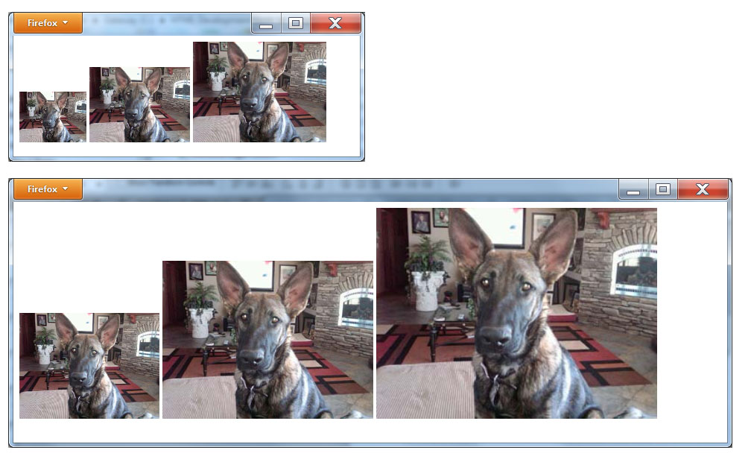
Specifying image sizes as a window percentage
<!DOCTYPE html> <html> <body> <img src="http://www.websitedevelopmentbook.com/Chapter02/dog.jpg" width="20%" /> <img src="http://www.websitedevelopmentbook.com/Chapter02/dog.jpg" width="30%" /> <img src="http://www.websitedevelopmentbook.com/Chapter02/dog.jpg" width="40%" /> </body> </html>

Slide 14
Size your images using photo-editing software
Using the <img> tag height and width attributes provides a fast way for designers to determine the image sizes they desire. After they determine the image size that they want, most designers will then use photo-editing software, such as Photoshop, to physically change the image size.
If you are increasing a photo’s size, the photo-editing software will normally produce a better result than will a browser. If you are instead, reducing an image’s size, the photo-editing software can do so and create a smaller image file size, which later will download faster when a user views your Web page.

Slide 15
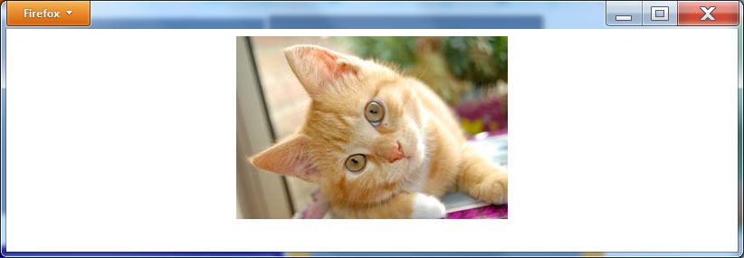
Centering an image
<!DOCTYPE html> <html> <body> <img style="display:block; margin-left:auto; margin-right:auto" src="http://www.websitedevelopmentbook.com/Chapter02/cat.jpg"/> </body> </html>

Slide 16
Images and copyrights
Before you place an image within a Web page, you must ensure that you have the legal right to do so. Otherwise, you may violate the owner of the image’s copyright. If you are unsure as to whether or not you have the right to use an image, you should request permission in writing from the owner.
If you don’t have permission to use an image, do not place the image on your Web site. Simply finding an image on the Web does not give you the right to use the image. Likewise, changing the image in some way (such as cropping or sizing the image) does not give you permission to use the image.
Several sites on the Web provide images on a royalty basis and royalty-free basis. Use a search engine to search for sites, such as Shutterstock, that provide royalty-free images.

Slide 17
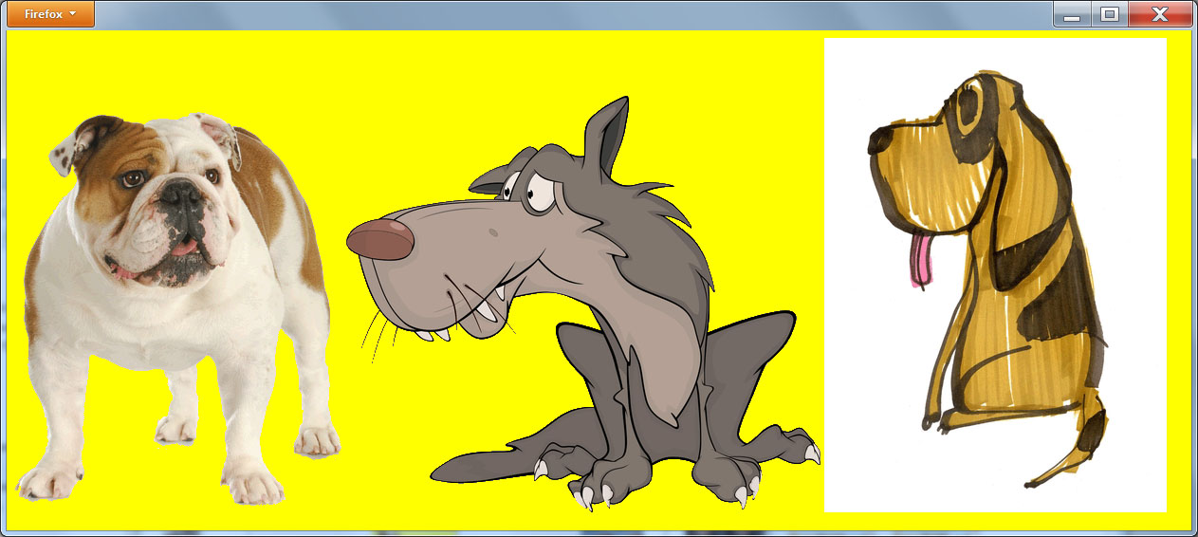
GIF Images
<!DOCTYPE html> <html> <body bgcolor="yellow"> <img src="http://www.websitedevelopmentbook.com/Chapter02/Bulldog.gif"/> <img src="http://www.websitedevelopmentbook.com/Chapter02/Animateddog.gif"/> <img src="http://www.websitedevelopmentbook.com/Chapter02/DogClipArt.gif"/> </body> </html>

Slide 18
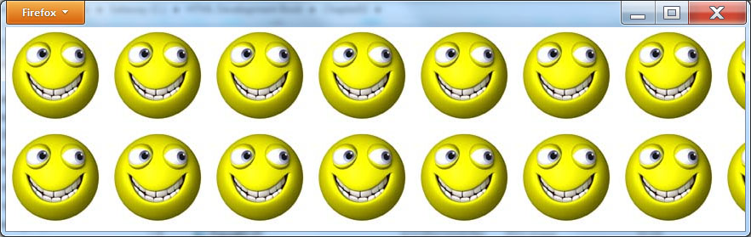
Displaying an image as a page background
<!DOCTYPE html> <html> <head> <style type="text/css"> body { background-image:url("http://www.WebSiteDevelopmentBook.com/Chapter02/smiley.jpg"); background-repeat:repeat; } </style> </head> <body> </body> </html>

Slide 19
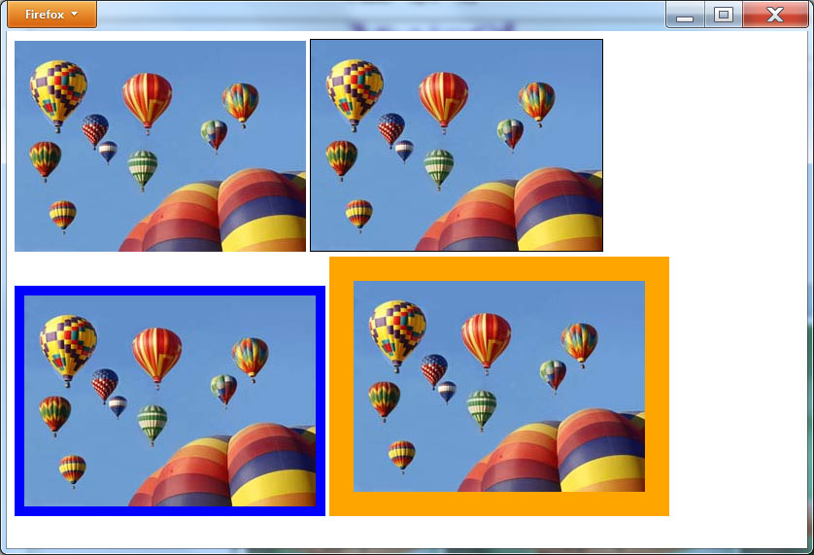
Controlling an Image Border
<!DOCTYPE html> <html> <body> <img src="http://www.WebSiteDevelopmentBook.com/Chapter02/balloons.jpg"/> <img src="http://www.WebSiteDevelopmentBook.com/Chapter02/ balloons.jpg" style="border:1px solid black"/><br/> <img src="http://www.WebSiteDevelopmentBook.com/Chapter02/ balloons.jpg" style="border:10px solid blue"/> <img src="http://www.WebSiteDevelopmentBook.com/Chapter02/ balloons.jpg" style="border:25px solid green"/><br/> </body> </html>

Slide 20
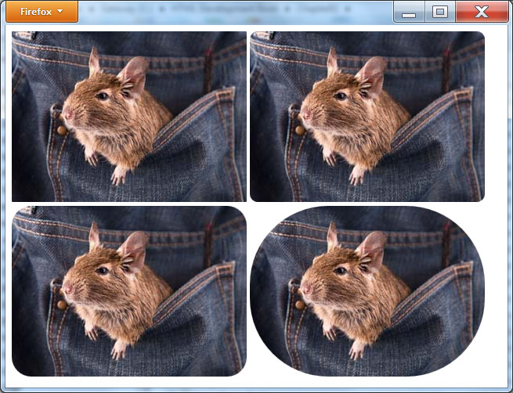
Controlling an image border radius
<!DOCTYPE html> <html> <body> <img src="http://www.WebSiteDevelopmentBook.com/Chapter02/mouse.jpg" style="border-radius:1px"/> <img src="http://www.WebSiteDevelopmentBook.com/Chapter02/mouse.jpg" style="border-radius:10px"/><br/> <img src="http://www.WebSiteDevelopmentBook.com/Chapter02/mouse.jpg" style="border-radius:25px"/> <img src="http://www.WebSiteDevelopmentBook.com/Chapter02/mouse.jpg" style="border-radius:100px"/> </body> </html>

Slide 21

Padding an image
<!DOCTYPE html> <html> <body> <img src="http://www.WebSiteDevelopmentBook.com/Chapter02/wine01.jpg" width="300" height="200"/> <img src="http://www.WebSiteDevelopmentBook.com/Chapter02/wine02.jpg" width="300" height="200"/> <img src="http://www.WebSiteDevelopmentBook.com/Chapter02/wine03.jpg" width="300" height="200"/><br/> <img src="http://www.WebSiteDevelopmentBook.com/Chapter02/cigar01.jpg" width="300" height="200"/> <img src="http://www.WebSiteDevelopmentBook.com/Chapter02/cigar02.jpg" width="300" height="200"/> <img src="http://www.WebSiteDevelopmentBook.com/Chapter02/cigar03.jpg" width="300" height="200"/> </body> </html>

Slide 22
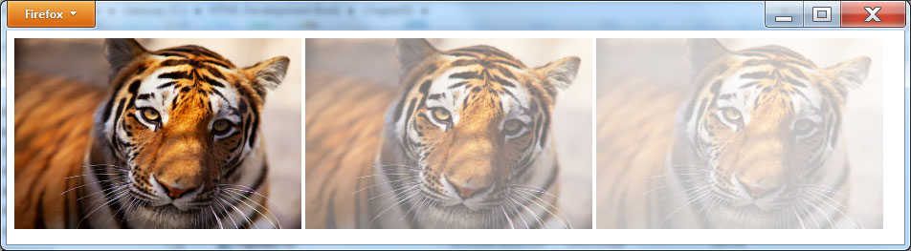
Adjusting image opacity
<!DOCTYPE html> <html> <body> <img src="http://www.WebSiteDevelopmentBook.com/Chapter02/tiger.jpg" width="300" height="200" /> <img src="http://www.WebSiteDevelopmentBook.com/Chapter02/tiger.jpg" width="300" height="200" style="opacity:0.55"/> <img src="http://www.WebSiteDevelopmentBook.com/Chapter02/tiger.jpg" width="300" height="200" style="opacity:0.25"/> </body> </html>

Slide 23
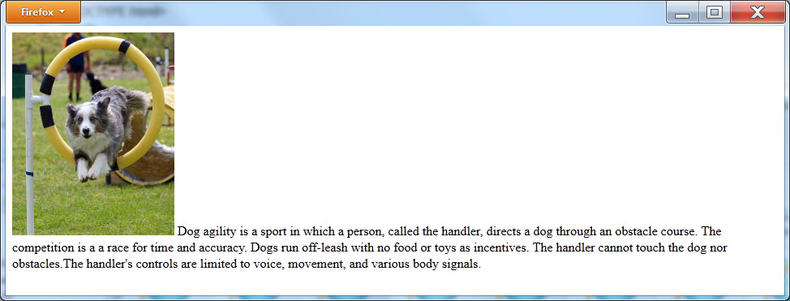
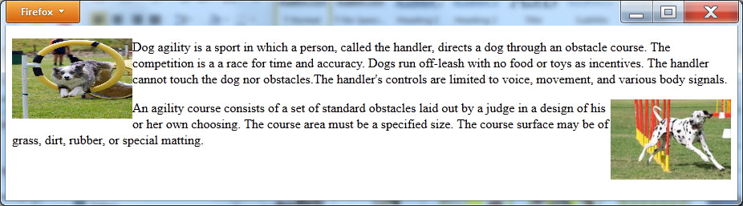
Aligning text and images
<!DOCTYPE html> <html> <body> <img src="http://www.WebSiteDevelopmentBook.com/Chapter02/doghoop.jpg" width="150" height="100" style="float:left"/><p> Dog agility is a sport in which a person, called the handler, directs a dog through an obstacle course. The competition is a a race for time and accuracy. Dogs run off-leash with no food or toys as incentives. The handler cannot touch the dog nor obstacles.The handler's controls are limited to voice, movement, and various body signals.</p> <img src="http://www.WebSiteDevelopmentBook.com/Chapter02/agility.jpg" width="150" height="100" style="float:right"/> <p>An agility course consists of a set of standard obstacles laid out by a judge in a design of his or her own choosing. The course area must be a specified size. The course surface may be of grass, dirt, rubber, or special matting. </p> </body> </html>

Slide 24
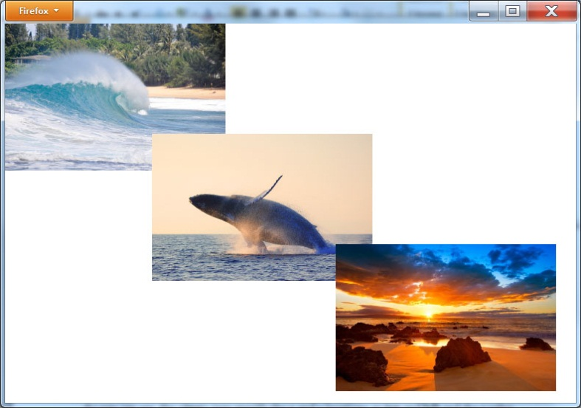
Positioning images at absolute locations
<!DOCTYPE html> <html> <body> <img src="http://www.WebSiteDevelopmentBook.com/Chapter02/maui01.jpg" width="300" height="200" style="position:absolute; top: 0px; left:0px; z-index:0"/> <img src="http://www.WebSiteDevelopmentBook.com/Chapter02/maui02.jpg" width="300" height="200" style="position:absolute; top:150px; left:200px; z-index:1"/> <img src="http://www.WebSiteDevelopmentBook.com/Chapter02/maui03.jpg" width="300" height="200" style="position:absolute; top:300px; left:450px; z-index:2"/> </body> </html>

Slide 25
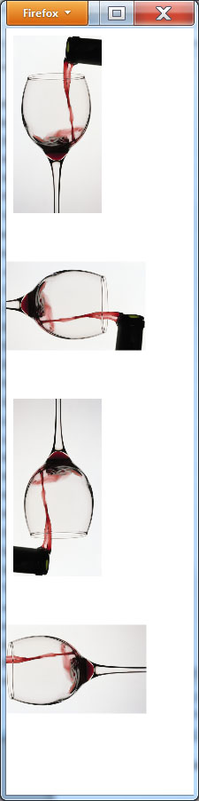
Rotating an image
<!DOCTYPE html> <html> <body> <img src="http://www.WebSiteDevelopmentBook.com/Chapter02/wine04.jpg" width="200" height="300" /> <img src="http://www.WebSiteDevelopmentBook.com/Chapter02/wine04.jpg" width="200" height="300" style="-webkit-transform: rotate(90deg); -moz-transform: rotate(90deg); filter: progid:DXImageTransform.Microsoft.BasicImage(rotation=1);"/><br/> <img src="http://www.WebSiteDevelopmentBook.com/Chapter02/wine04.jpg" width="200" height="300" style="-webkit-transform: rotate(180deg); -moz-transform: rotate(180deg); filter: progid:DXImageTransform.Microsoft.BasicImage(rotation=2);"/> <img src="http://www.WebSiteDevelopmentBook.com/Chapter02/wine04.jpg" width="200" height="300" style="-webkit-transform: rotate(270deg); -moz-transform: rotate(270deg); filter: progid:DXImageTransform.Microsoft.BasicImage(rotation=3);"/> </body> </html>

Slide 26
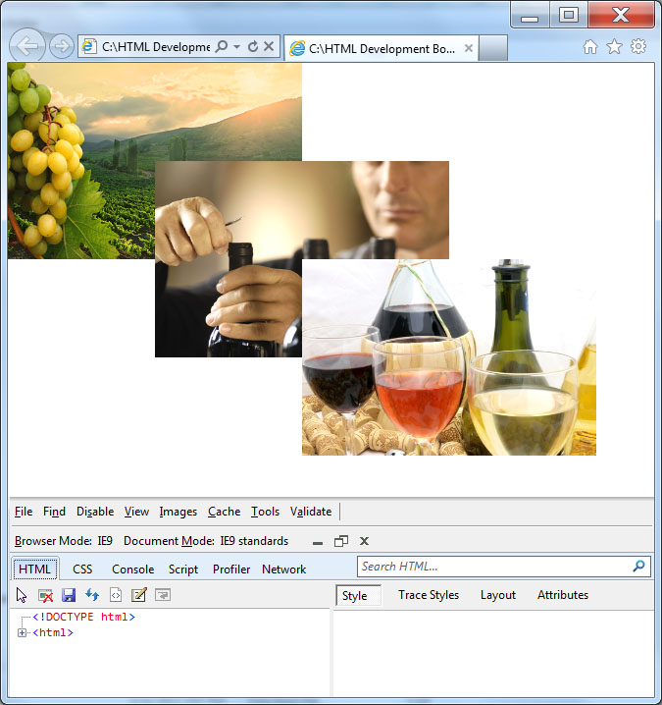
Real world – browser support for developers

Slide 27
summary
Across the Web, sites make extensive use of graphics images. To place an image within an HTML page, you use the <img> tag.
Using various style attributes, you have complete control over image sizing and placement. In addition you learned that when you upload an HTML page to a Web server, you must also upload the corresponding graphics images.
Depending on where you place the images on the server, you might use relative or absolute URLs within the <img> tag src attribute.
Using various image styles, you learned how to center, border, pad, rotate, and align images.

